Slide 1
Workplace Ninjas US 2025 Webinar

Slide 2
Introduction
Mission Statement
Leadership Team
History of Workplace Ninjas
Founding Sponsors
The Venue
The Room Block
Call for Papers
Sneak Peak on What to Expect in Dallas

Slide 3
Mission Statement
Our goal is to bring the crowd of workplace management and security ninjas together to share their knowledge, learn together. This covers topics around management of endpoints with configuration manager and Intune, as well virtual desktops and the complete security stack of Microsoft.
Workplace Ninjas US is a cloud-native community focusing on numerous tracks:
Microsoft Intune
Microsoft Entra
Microsoft Security
Microsoft Copilot
Microsoft Desktop-as-a-Service (DaaS)
Diversity in Tech (Women in Tech and Neurodiversity Panels)

Slide 4
History of Workplace Ninjas
Workplace Ninjas has existed in Switzerland since 2020, with the first in-person conference in 2022.
Europe needed a dedicated premium Workplace Management and Security conference. There are many Azure and Office 365 related conferences in Europe but the topics for Workplace Management are often included as a single track or only a part of another track, but they never seem to be the primary focus. There is no major premium event in Europe dedicated exclusively to Endpoint Management in any manner. The Workplace Ninja Summit is here to fill this gap and provide exclusive focus on Microsoft and other cloud computing topics.
Workplace Ninjas is both a business and technology conference. We will have world-class experts and speakers, both from Microsoft Corporate and from the community (Microsoft MVPs), focusing not only on the newest features of Microsoft technologies and general cloud topics, but also on the business aspects of working with device management technologies. Our content is focused on engineers and architects with level 300-500 sessions.

Slide 5
Leadership Team

Slide 6
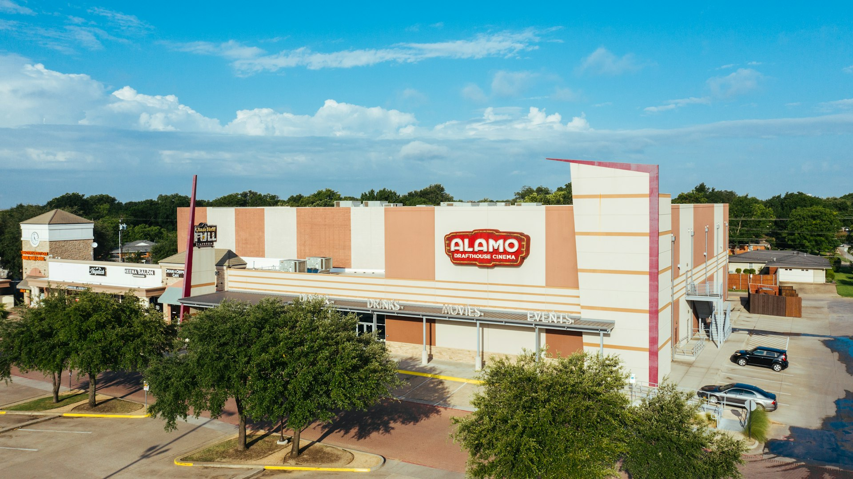
The Venue
Our Inaugural Conference is coming!!
December 9th and 10th at Alamo Drafthouse in Richardson (just outside of Dallas, TX)
Registration opens February 17th

Slide 7
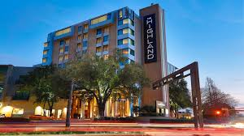
The Hotel
The Room Block is:
The Highland Dallas, Curio Collection by Hilton 4-Star Hotel
$199/night
Room Block available 12/8-12/10

Slide 8
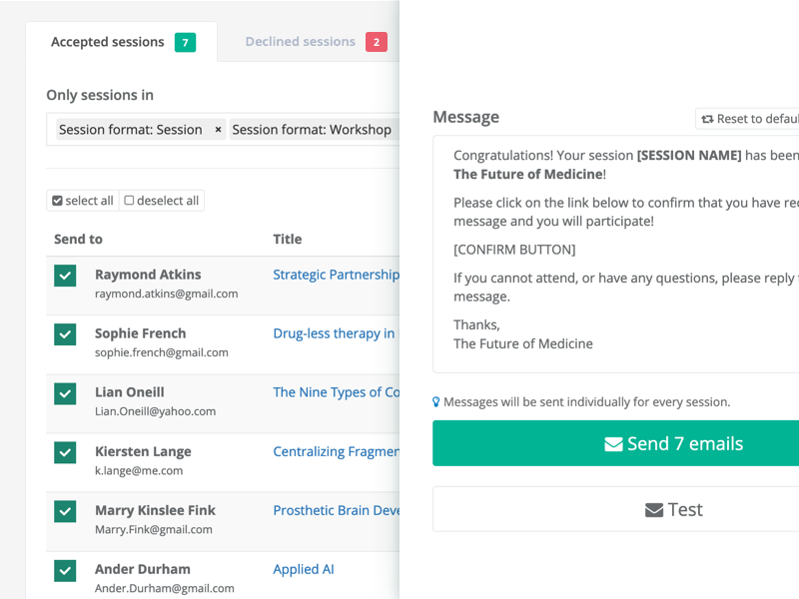
Call for Papers
The Call for Papers will open tentatively in April. Some of the highlights from a session perspective:
Sponsored Sessions from Top Microsoft Partners
Women in Tech Panel
Neurodiversity in Tech Panel
5 Tracks:
Intune
DaaS
Entra
Security
Copilot
Incredible Microsoft MVP speakers and Microsoft staff are already tentatively scheduled to speak and appear.

Slide 9
Founding Sponsors
Gold Sponsors
Silver Sponsors

Slide 10
Sneak Peak Into the Experience
Wait Till You See What We Have Planned….

Slide 11
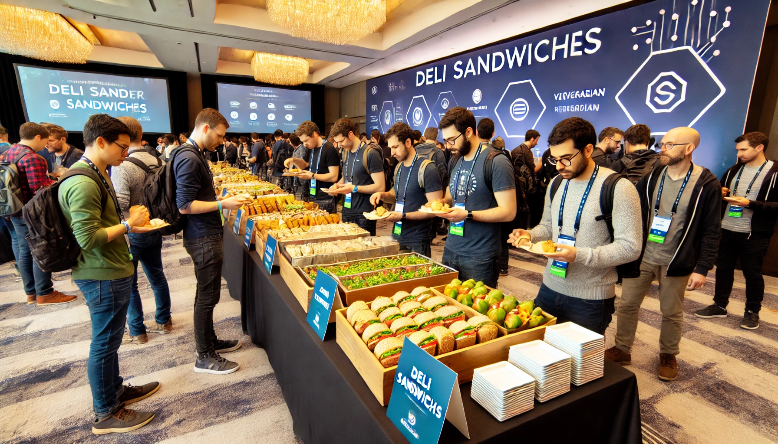
Let’s Talk About Food
This is what your typical conference lunch looks like:

Slide 12
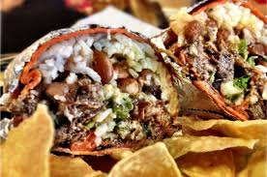
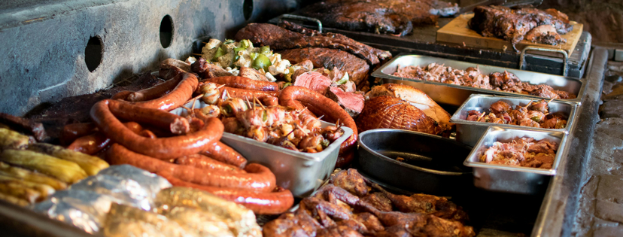
Let’s Talk About Food Cont.
This is what Workplace Ninjas will look like:
Day 1: Catered with a Burrito Bar by Freebirds World Burrito
Day 2: Catered by Hard Eight BBQ with live brisket carving onsite
Our Expo Reception will serve:
Caprese Skewers
Chicken Skewers with “Dirty Martini” Aioli
Corn & Jalapeno Fritters
Beer and Wine Open Bar

Slide 13
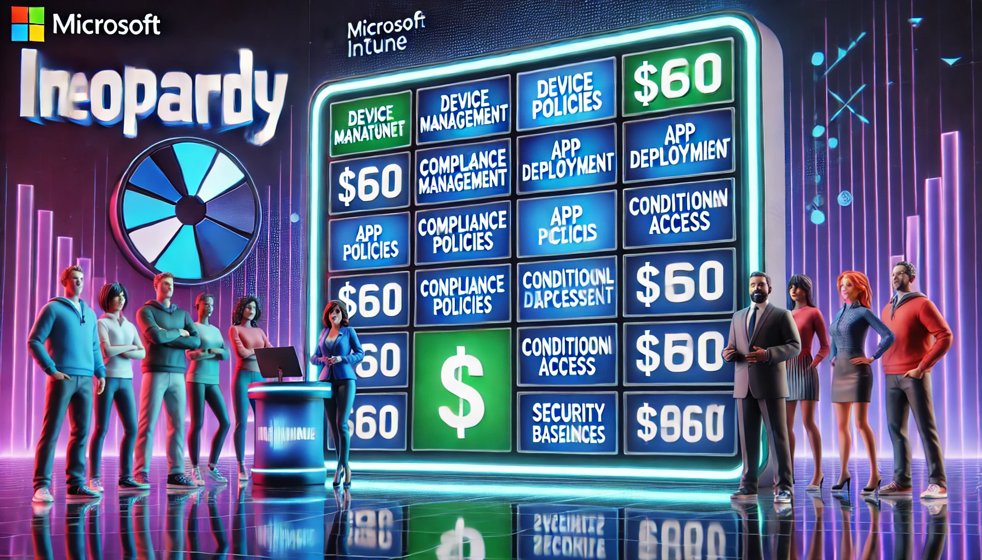
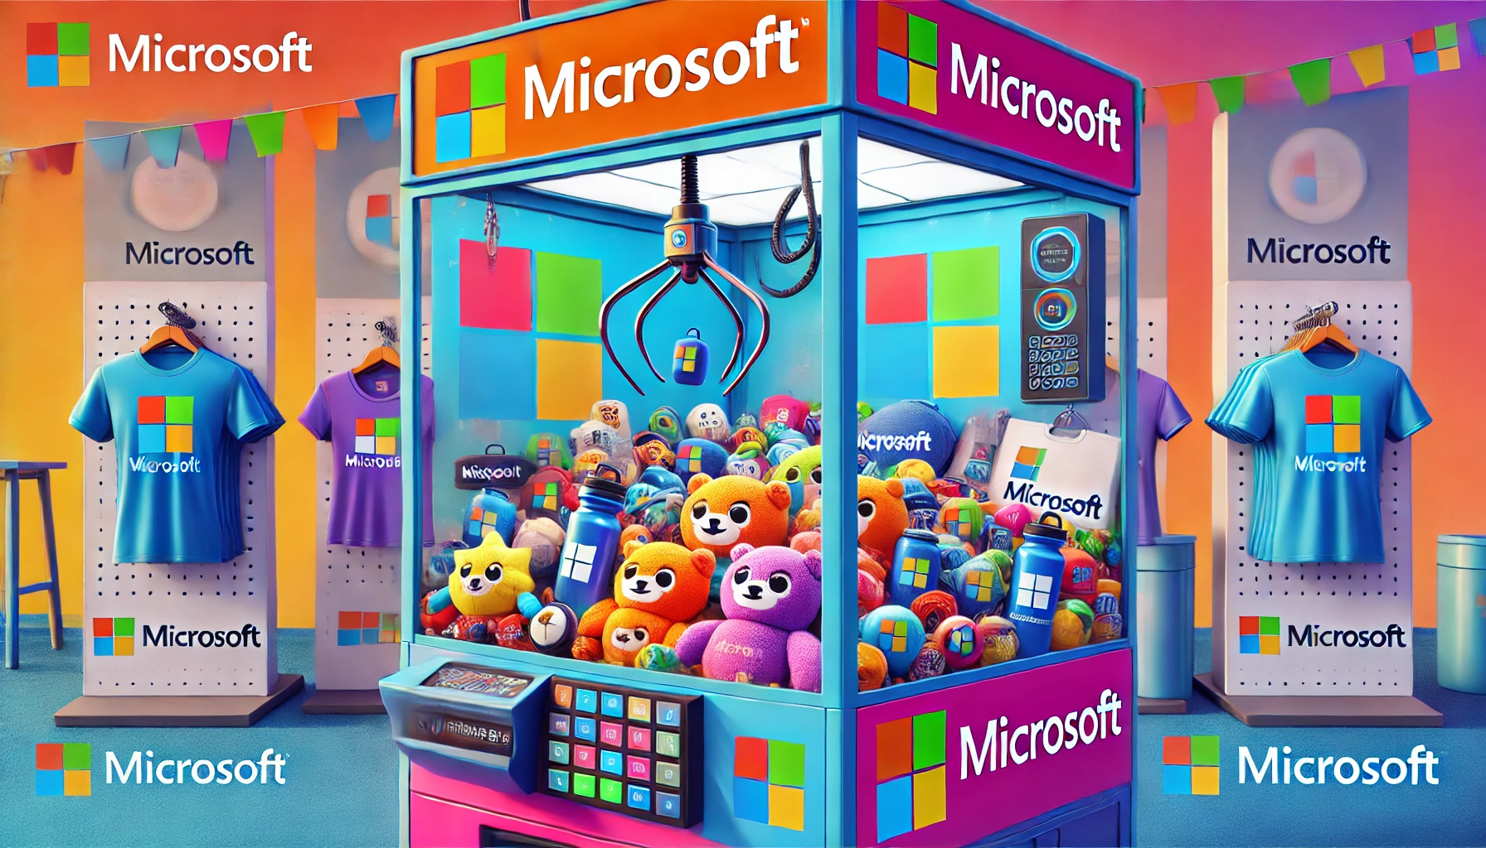
Immerse Attendee Experience
We are heavily focused on cultivating an amazing attendee experience. A few of the things we are happy to announce at this point:
A claw machine with Microsoft and Ninjas swag
Guest Commentators
Intune Jeopardy
Buzzword Bingo

Slide 14
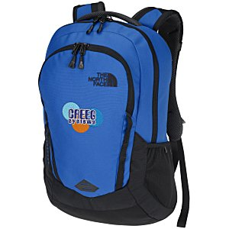
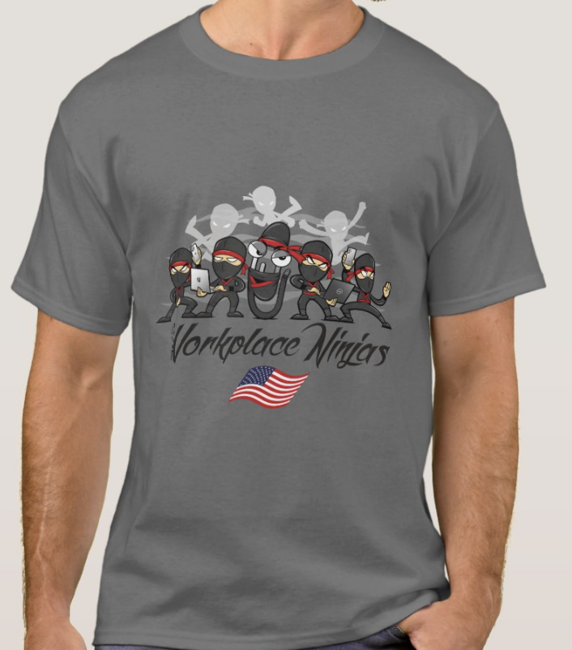
Swag Preview
We have some very cool swag planned as well:
The North Face Backpacks
USB Lanyards
Ninjas Branded Swag

